Slide 1
ADD TITLE HERE

Slide 2
ADD title here
Add text here; or
Place a chart or graphic here; or
  Please write alternative text (alt text) for each chart and graphic in the “Convening_Alt-text_Template” document
Place an image or photo here
  Please write alt text for each image and photo in the “Convening_Alt-text_Template” document
If you need assistance with slide preparation, please contact Rebecca Moyer
  Email: rmoyer@rti.org
  Direct line: 503-428-5679

Slide 3
ADD title here
Subtitle
Add text, graphics, charts, or photos here
Remember to write alt text for each in the “Convening_Alt-text_Template” document

Slide 4

Add subtitle here
ADD title here
Add text here
Remember to write alt text in the “Convening_Alt-text_Template” document

Slide 5
ADD title here
Add text about chart here
Remember to write alt text for each in the “Convening_Alt-text_Template” document
Please category and data value labels (not just color) in pie charts whenever possible to help maintain 508 compliance

Slide 6
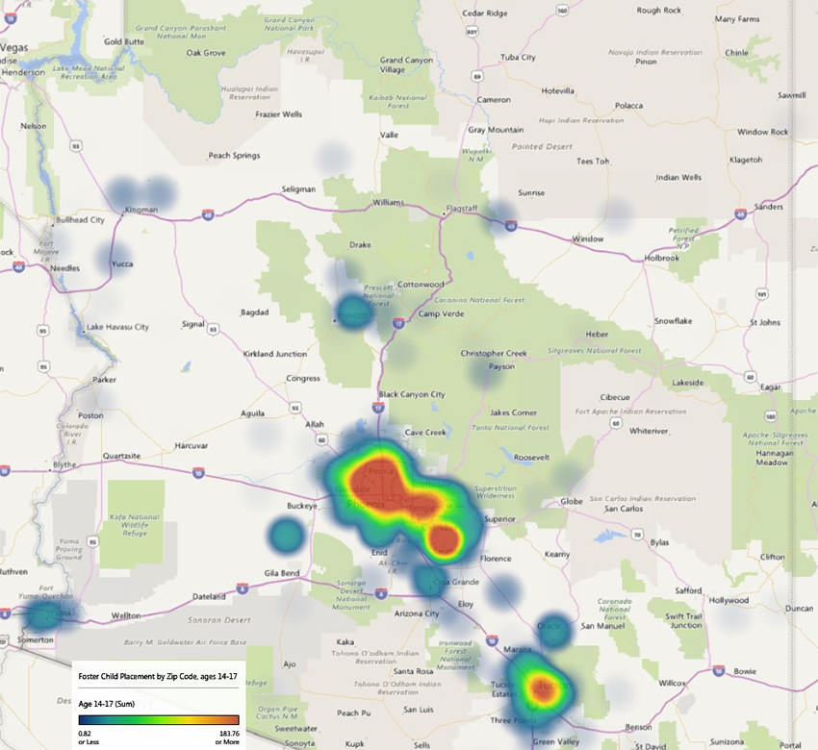
ADD title here
Add text here
Remember to write alt text for each in the “Convening_Alt-text_Template” document

Slide 7
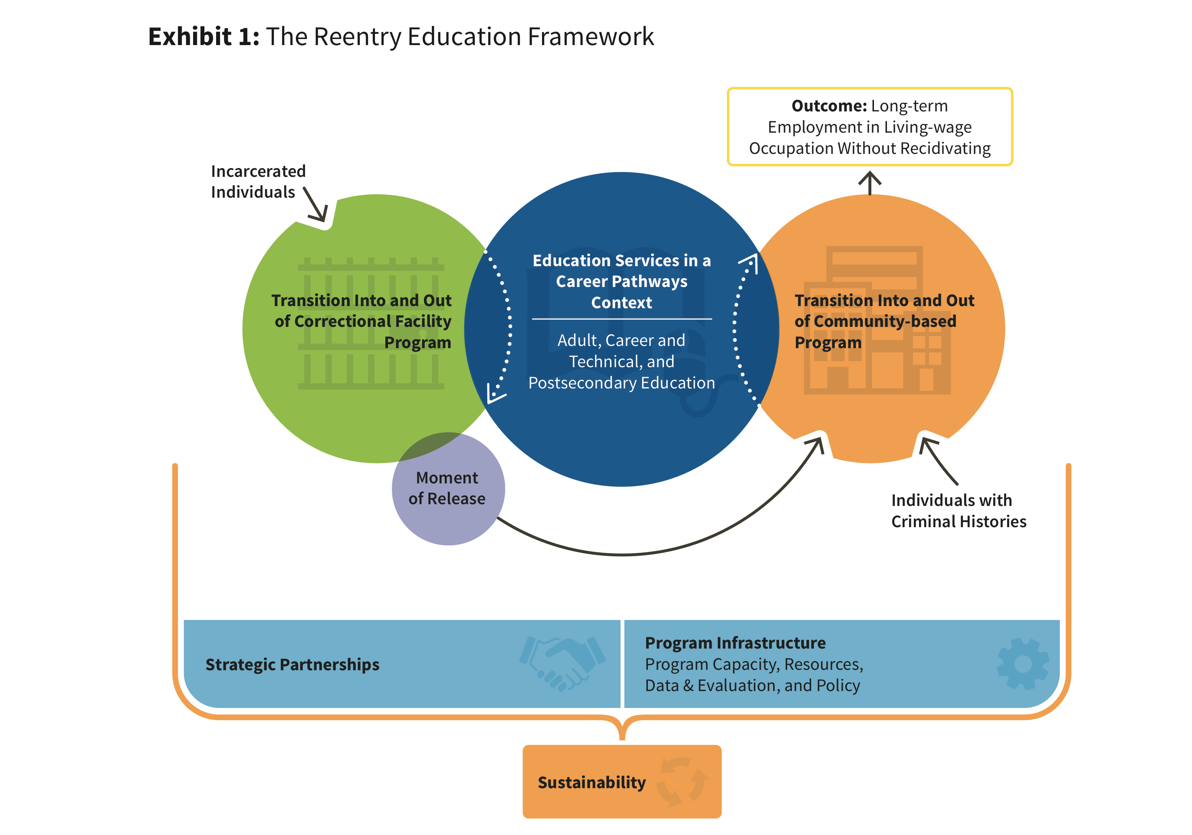
ADD TITLE HERE
More complex graphics should be grouped or made into an image
Remember to write alt text in the “Convening_Alt-text_Template” document
Limit the number of slides in your deck to 6 plus the title page
Thank you!

